Slide 1

Convolutional Neural Network based Image/ Video Colorization using OpenCV
Under the guidance of : Prof. Rajdeep Chatterjee
Prepared by:
Amrit Ghosh (1729009)
Arpan Roy Chowdhury(1729016)
Avirupa Saha (1729021)
Krishnendu Kundu (1729030)
Ritwik Das (1729054)

Slide 2
Contents
01 Introduction
02 CNN
03 Colorization problem
04 Architecture of the model
05 Results
07 Conclusion
08 Future work

Slide 3
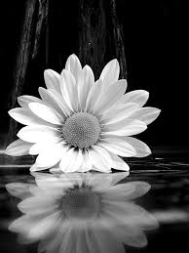
Introduction
Colorizing black and white films is a very old idea dating back to 1902. For decades many movie creators opposed the idea of colorizing their black and white movies.Today it is accepted as an enhancement to the art form.
Image colorization is the process of taking an input grayscale (black and white) image and then producing an output colorized image that represents the semantic colors and tones of the input.
Previous methods for image colorization either:
Relied on significant human interaction and annotation
Produced desaturated colorization

Slide 4
Convolutional Neural Network
A Convolutional Neural Network (ConvNet/CNN) is a Deep Learning algorithm which can take in an input image, assign importance (learnable weights and biases) to various aspects/objects in the image and be able to differentiate one from the other. The pre-processing required in a ConvNet is much lower as compared to other classification algorithms.
1

Slide 5
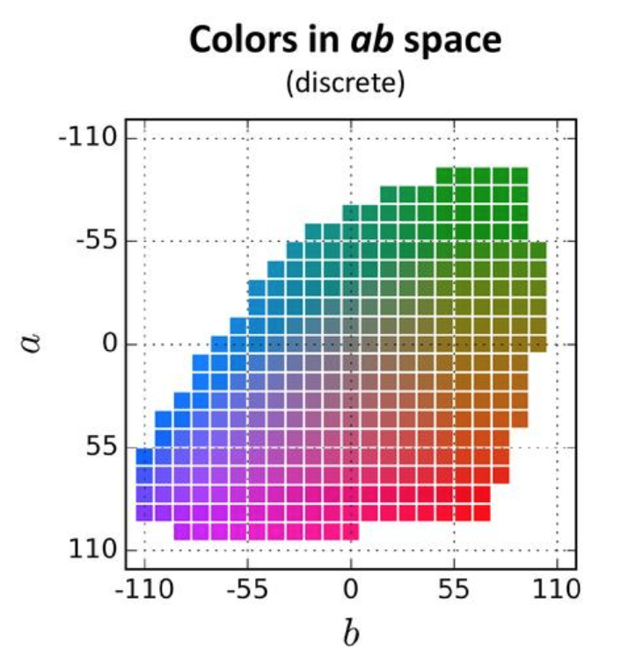
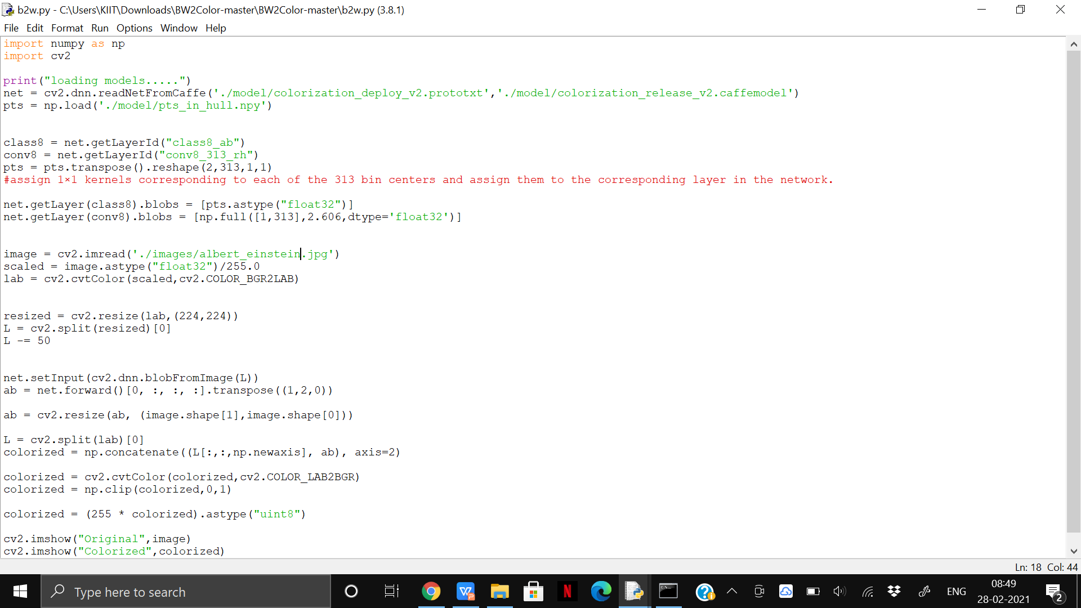
Colorization Problem
Unlike the RGB color space the CIE Lab color space has color information encoded only in the a (green-red component) and b (blue-yellow component) channels. The L (lightness) channel encodes intensity information only.
The black and white image is the L channel and we had to find the ab values. this becomes quite easy to find using two OpenCV function known as cvtColor and COLOR_BGR2LAB.
The ab space is quantized into 313 bins. Instead of finding the a and b values for every pixel, because of this quantization, we simply need to find a bin number between 0 and 312. (multinomial classification for every gray pixel there are 313 classes to choose)

Slide 6
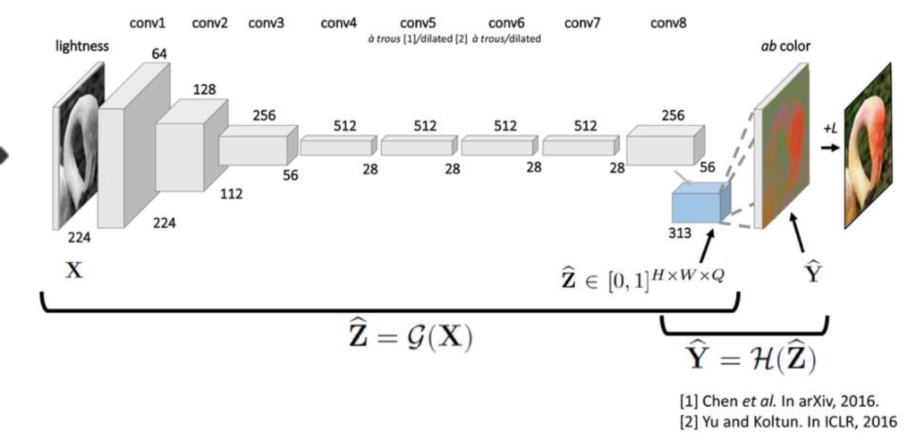
Architecture for colorization
Each block has two or three convolutional layers followed by a Rectified Linear Unit (ReLU) and terminating in aBatch Normalization layer.
The input image is rescaled to 216×216. When it passes through the neural network shown above, it gets transformed to the neural network.
For each pixel contains a vector of values where each value represents the probability of it belonging to the same class.
Combining the input L channel with the predicted ab channels.And converting the Lab image back to RGB.
The results of the training which was done in Caffe are very impressive. These results have been integrated into the DNN module of OpenCV.

Slide 7
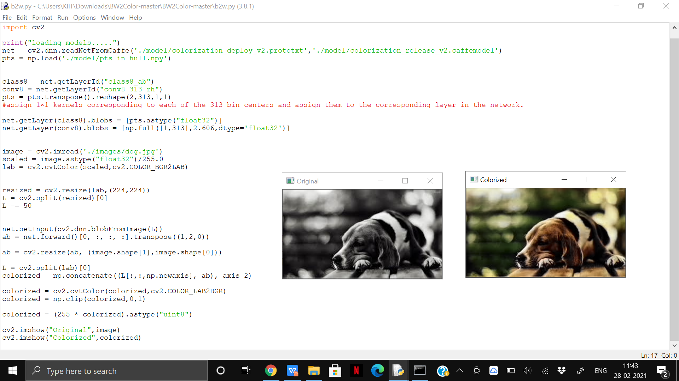
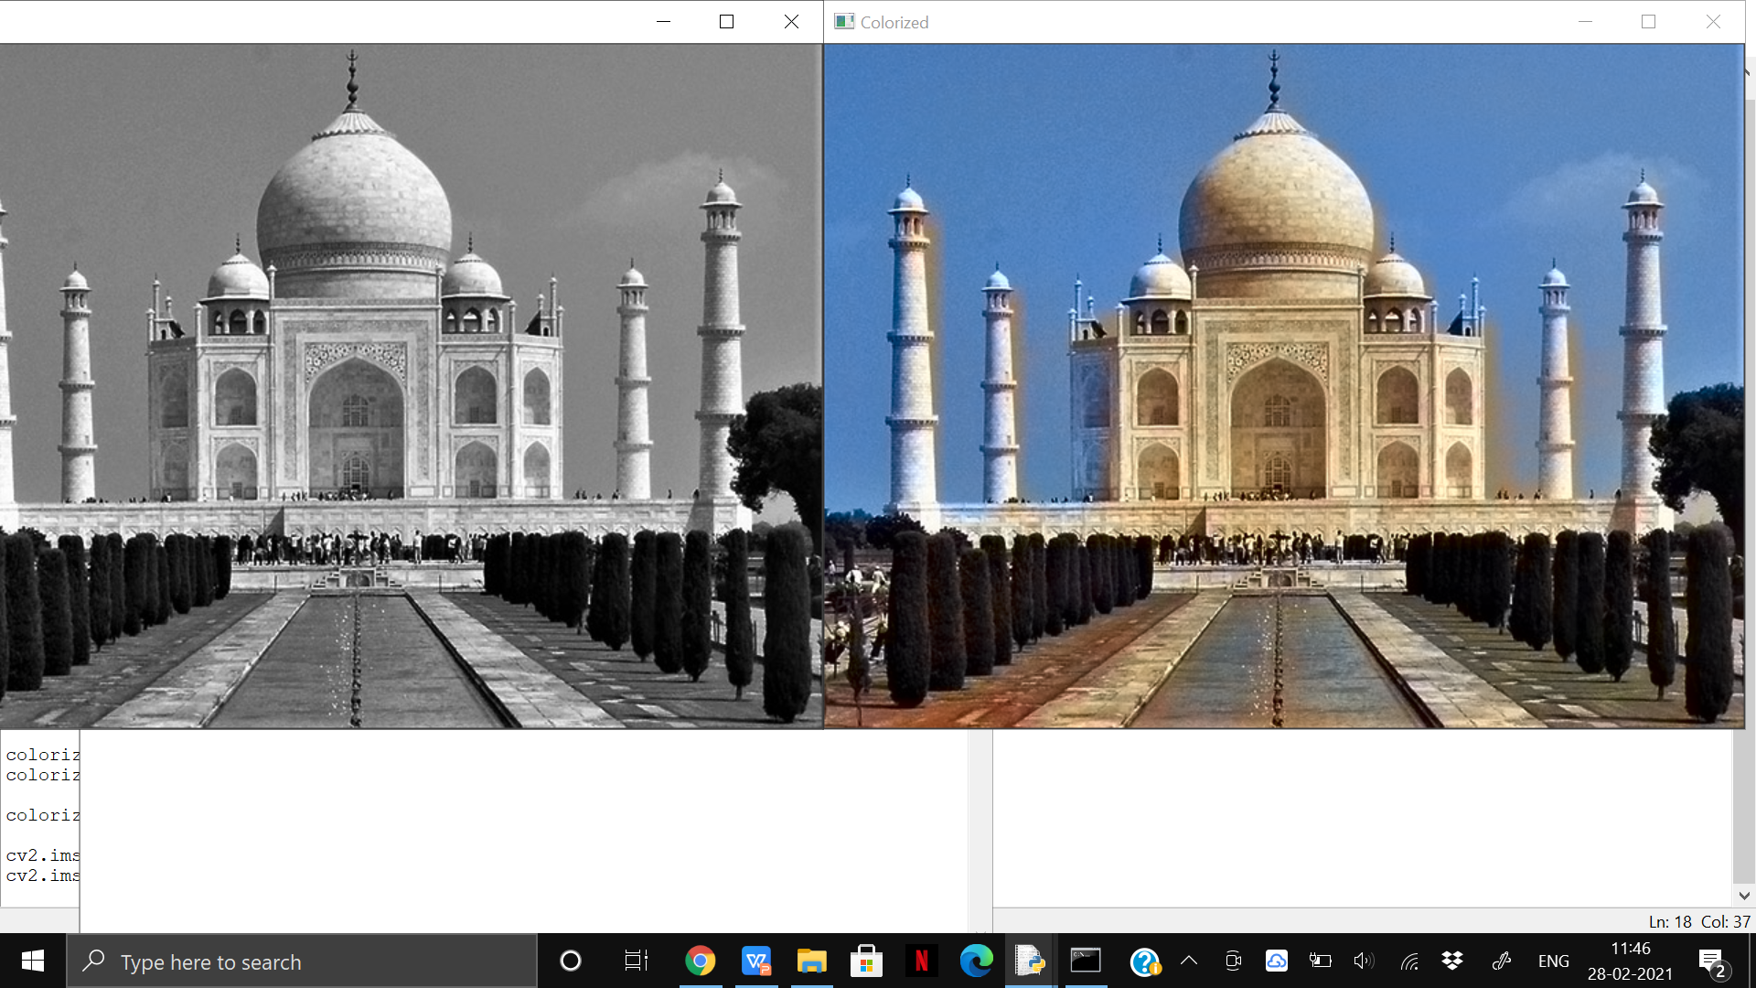
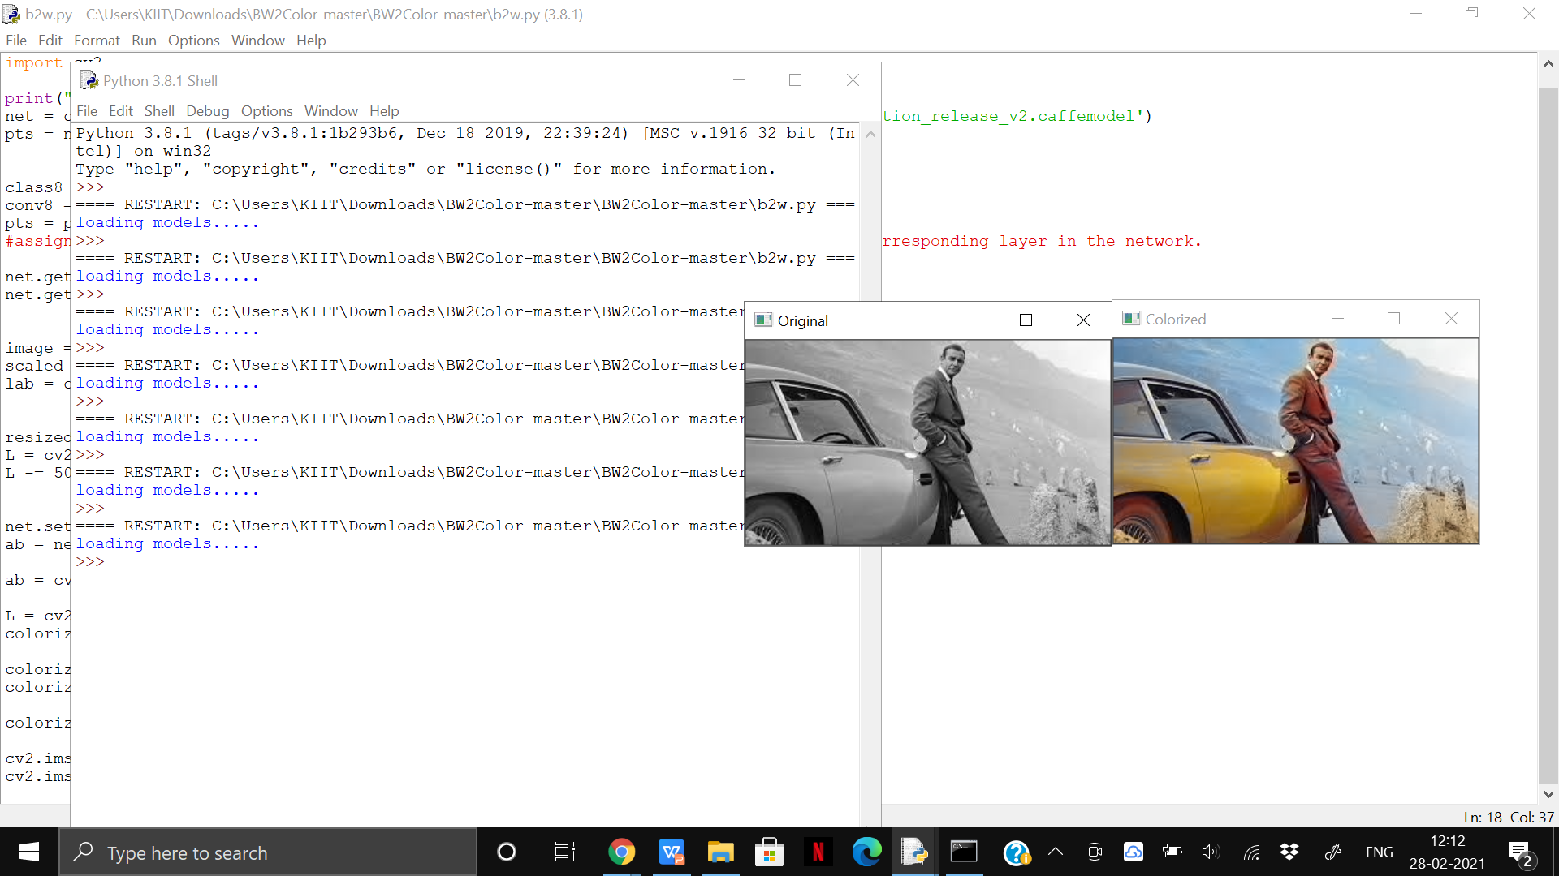
Results

Slide 8
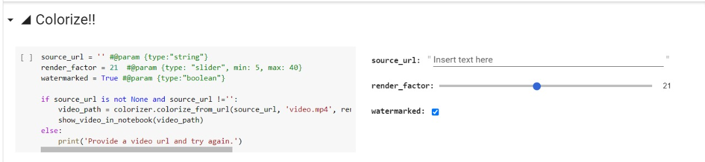
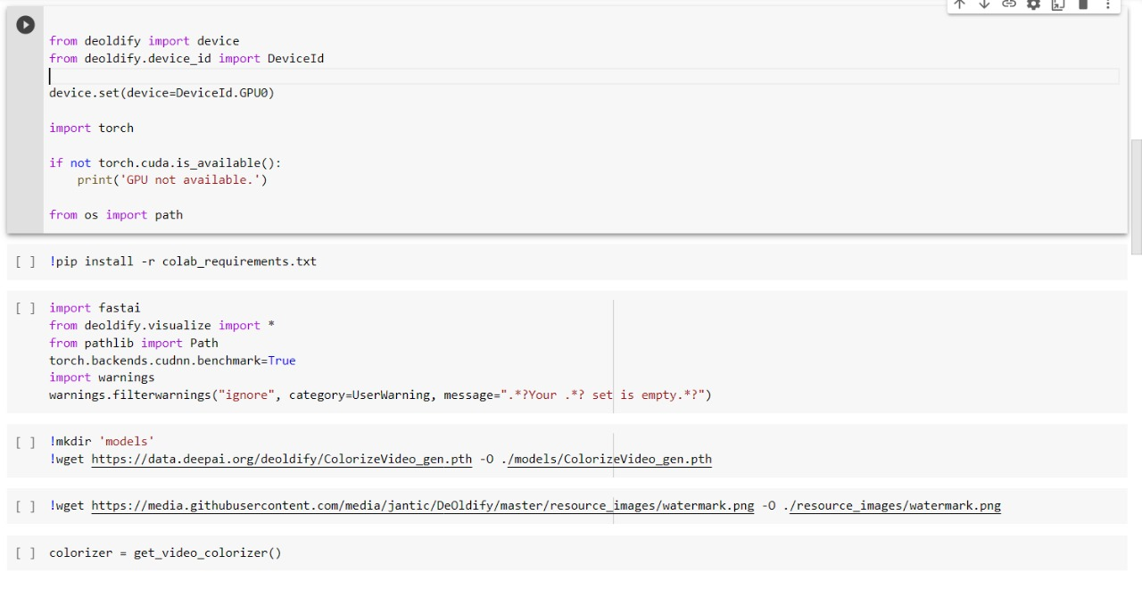
For Video Colourization
Deoldify is a new effective technique for image to image GAN(Generative adversarial network) training. It gives smooth, consistent, and flicker free video. It colourizes every single frame and then it will merge them into a final colourize video.

Slide 9
Conclusion
While image colorization is a boutique computer graphics task, it is also an instance of a difficult pixel prediction problem in computer vision. Here we have shown that colorization with a deep CNN and a well-chosen objective function can come closer to producing results indistinguishable from real color photos.
Our method not only provides a useful graphics output, but can also be viewed as a pretext task for representation learning. Although only trained to color, our network learns a representation that is surprisingly useful for object classification, detection, and segmentation, performing strongly compared to otherself-supervised pre-training methods.

Slide 10
Future Work
The model accuracy can be improved if the classification layer model improves.
Sometimes it is becomming difficult to restore same color to images which contains multiple different colors.
The output which we got are more convincing images on nature themes. It is the case because the candidate colors for objects in nature are more well defined than some man-made objects.

Slide 11
THANK YOU

